Slide 1
Normalization…

Slide 2
Find all candidate keys of R(School, class, batch, principal, student, teacher)
FD’s are
School, class ->batch,
batch -> principal, student,
Student -> teacher,
principal -> school

Slide 3
Find all candidate keys of R(School, class, batch, principal, student, teacher)
FD’s are
School, class ->batch,
batch -> principal, student,
Student -> teacher,
principal -> school
Ans:{ School,class},
{principal,class},
{batch,class}

Slide 4
1st NF
Each attribute should contain atomic values. Multivalued attributes not allowed.
Columns or attributes should contain values of the same domain type.
Columns should have unique names
Every table should have a primary key
No duplicate tuples
Std id | Name | Dept name | Building | school
1 | Rohit | Mat | PRP 102 | SAS
2 | Sanju | Computer Sc | SJT 602 | SCOPE
3 | Praveen | Mat | PRP 102 | SAS
4 | Praveen | Phy | TT 645 | SAS
5 | Ronald | Phy | TT 645 | SAS
6 | Singh | Computer Sc | SJT 602 | SCOPE

Slide 5
2NF
Relation R is in 1NF and,
A relation schema R is in 2NF if every nonprime attribute A in R is fully functionally dependent on the primary key of R.
Partial dependency occurs when a non-key attribute is dependent on only a part of a composite primary key (a primary key that consists of more than one attribute).
Or Proper subset of candidate key determines any Non prime attribute then we have partial dependency.

Slide 6
Is R(A,B,C,D) in 2NF form.
FD’s are {AB ->CD, C ->A, D -> B}
Is R(P,Q,R,S) in 2NF form.
FD’s are {P ->Q, Q -> R, R -> S}
Is R(P,Q,R,S,T,U) in 2NF form.
FD’s are {P ->Q, Q -> R, R -> S, S ->T }

Slide 7
Is R(A,B,C,D) in 2NF form.
FD’s are {AB ->CD, C ->A, D -> B}
It is in 2NF, Here we get all attributes are prime attributes
Is R(P,Q,R,S) in 2NF form.
FD’s are {P ->Q, Q -> R, R -> S}
It is in 2NF, P the key has no proper subset.
Is R(P,Q,R,S,T,U) in 2NF form.
FD’s are {P ->Q, Q -> R, R -> S, S ->T }
It is not in 2NF, PT is the key and P ->Q .

Slide 8
3NF
According to Codd’s original definition, a relation schema R is in 3NF if it satisfies 2NF and no nonprime attribute of R is transitively dependent on the primary key
Transitive dependency: A transitive dependency occurs when a non-key attribute depends on another non-key attribute, rather than directly on the primary key. In other words, if you have a table where attribute A determines attribute B, and attribute B determines attribute C, then attribute C is transitively dependent on attribute A through B

Slide 9


Conditions to
Is R(P,Q,R,S) in 3NF form.
FD’s are {P ->Q, Q -> R, R -> S}
Not in 3NF form, because R -> S

Slide 10
Conditions to
Is R(P,Q,R,S) in 3NF form.
FD’s are {P ->Q, Q -> R, R -> S}

Slide 11
Is R(A,B,C,D) in 3NF form.
FD’s are {AB ->CD, C ->A, D -> B}
Yes its in 3NF

Slide 12
Decomposition to small tables:
Dependency preserving and lossless join property should always be satisfied.
If we decompose R(A,B,C) with Functional dependencies A ->BC and BC -> A to R1(A,B) and R2(BC), is it a dependency preserving decomposition.?
A set of functional dependencies F is said to cover another set of functional dependencies E if every FD in E is also in F+; that is, if every dependency in E can be inferred from F; alternatively, we can say that E is covered by F.
Two sets of functional dependencies E and F are equivalent if E⁺ = F ⁺. Therefore, equivalence means that every FD in E can be inferred from F, and every FD in F can be inferred from E; that is, E is equivalent to F if both the conditions—E covers F and F covers E—hold.
The decomposition of relation schema R with FDs F into schemas with attribute
sets X and Y is dependency-preserving if (FX ∪ FY ) ⁺= F⁺.

Slide 13
R(A,B,C) with FD say F: A ->BC , BC -> A decomposing to R1(A,B) and R2(B,C)
Find the derived FD’s for all the sub relations
To derive all the sub relations find the closure of all attribute subsets of attributes in individual sub relation and avoid trivial or redundant functional dependency
For R1(A,B)
Compute Closure of A = {A,B,C} so A -> A is trivial. So remove A from the closure and also C is not in R1 so remove C from closure hence we get A -> B.
B closure is also {B} so B -> B is also trivial. So no need to consider.
AB closure is {A,B,C} where C doesn’t belong to R1 so remove C from closure but now we get AB -> AB which is also trivial. So need to consider.
So only FD’s derived are F1: A -> B
For R2(B,C) calculate B closure, C closure and BC closure but we get no nontrivial FD’s . So FD for R2 , i.e, F2: is nothing
Now if take union of F1 and F2 then all the FD;s in F should be valid in F1 union F2 and all the FD’s in F1 union F2 should be valid in F. or
Closure of Union of F1 and F2 is not equal to closure of F, So not dependency preserving.

Slide 14
Consider R(P,Q,R,S,T)
FD’s are {P ->Q, Q ->R, R -> S, S ->P}
Is the decomposition dependency preserving. R1(P,Q,R), R2(R,S,T)
Yes.
Consider R(P,Q,R,S,T)
FD’s are {P ->QRS, Q ->PT, QR -> PST, S ->T, R -> ST}
Is the decomposition dependency preserving. R1(P,Q), R2(Q,R), R3(R,S,T)
Yes.

Slide 15
Loss-less join property
The decomposition of the relation into sub relations should be having the loss less join property, i.e when you take the natural join of the sub relations you must get the same relation. No extra tuples should be added and no tuples should be lost. If it happens so then we call the decomposition as Lossy decomposition.
Points to note:
Common attributes should be there while decomposing
Union of attributes in the sub relations should be equal to the attribute set in R.
Common attribute should be superkey of atleast one sub relation then we will have a lossless join decomposition.

Slide 16
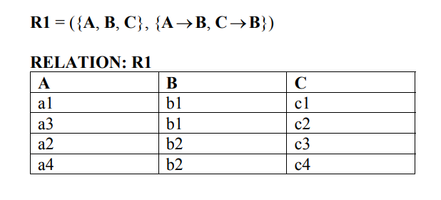
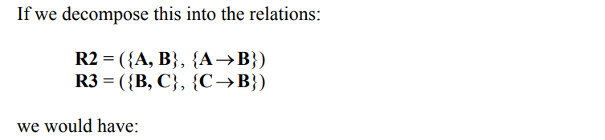
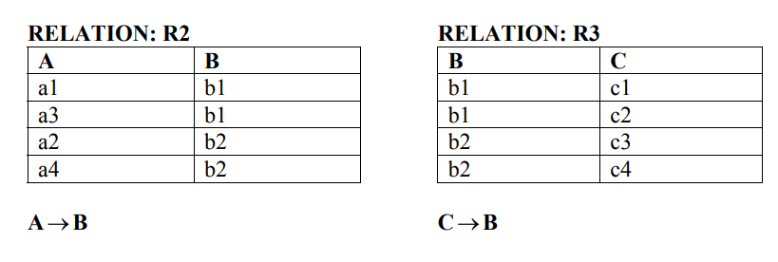

Slide 17
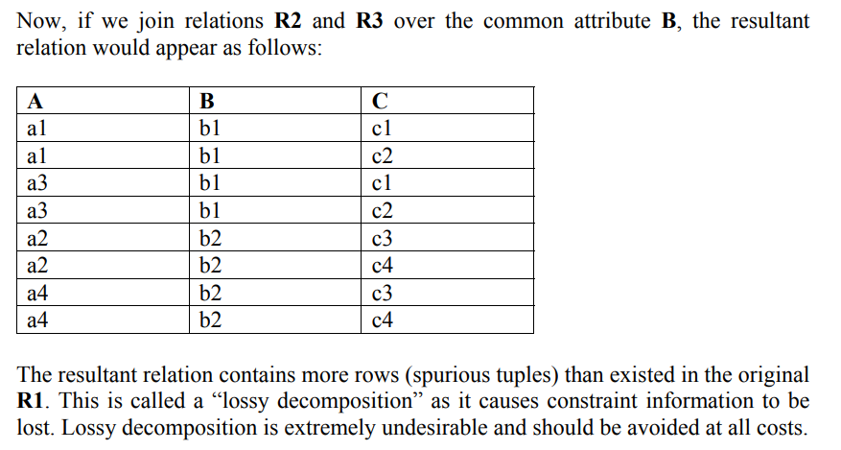

Slide 18
Check whether we have a loss less join decomposition for the relation
R(P,Q,R,S,T,U) with FD {PQ ->R,R ->S,S ->TU,U ->P,S ->Q,T ->U} to R1{P,Q,R}, R2{R,S,T},R3{T,U}

Slide 19
